Slide 1

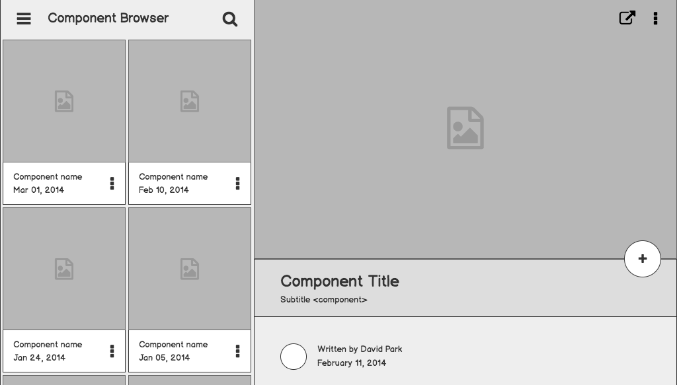

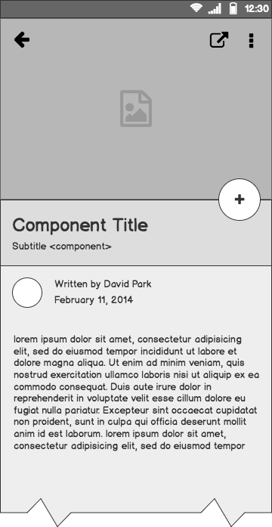
ERASMUS APPLICATION EXTENSION
Group #2A - ABKUY
Ahmet Şahin
Barış Tan Ünal
Kaan Berk Kabadayı
Uğur Can Altun
Yusuf Şenyüz

Slide 2
Outline
1.0. Design Patterns
2.0 Tech Stack
3.0. Erasmus Process 3.1. Login and User Types 3.2. Placement Procedure 3.3. Wish List Preparation & Pre-Approval Form 3.4. Additional Features

Slide 3
Problem & Solution
We have designed a web application that completes the functionalities of the existing website.
Automated placement algorithm.
No need for paperwork.
Possible to generate PDF’s of forms.

Slide 4
Design Patterns

Slide 5
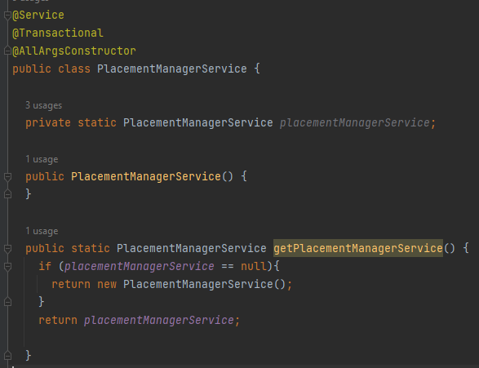
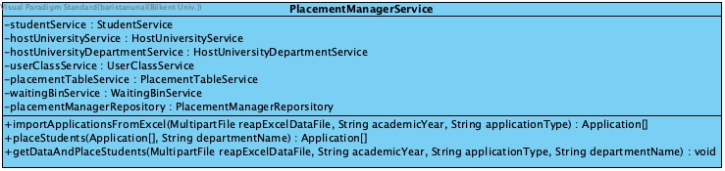
Singleton Design Pattern
Used singleton for all “Service” classes.
Has only one instance.
Provides global point of access to the class.

Slide 6
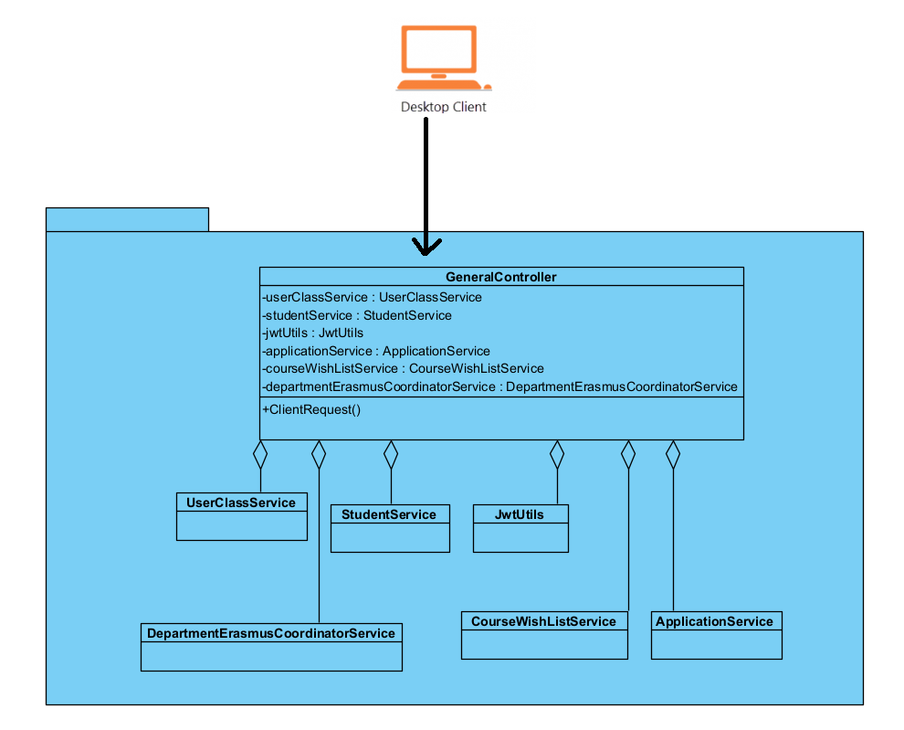
Façade Design Pattern
Used Façade with “Controller” classes.
“Controller” classes have “Service” instances.
Provides a unified interface to a set of interfaces.
Avoids tight coupling between clients and subsystems.

Slide 7
Tech Stack

Slide 8

Backend
Spring Boot
Spring Boot was chosen for the backend of the application due to developers’ pre-existing experience with Java and Spring Boot’s many advantages such as:
No XML configuration is required [1]
No need to make sure having all the bean dependencies being declared properly in the context file [1]
Simple Configuration [1]
Large Community
And many more!

Slide 9

Database
PostgreSQL
PostgreSQL is chosen for the database of the application due to:
Large Community
Compatible with Spring Boot [2]
Relational-Database [2]

Slide 10

Frontend
React is chosen for the frontend of the application due to:
- Fast development process with component feature [3]
- Powerful libraries such as React Router, React Redux and Redux Toolkit
- Developer-friendly API call libraries such as Axios and RTK Query

Slide 11

API Platform
Postman API
Used for API testing and integration [4].
Send requests for each new feature.

Slide 12
Some Assumptions
International Students Office uploads a valid Excel file with proper column order (total points, student ID’s, preferred universities).
The information about the students such as their faculty, department, curriculum; is present on STARS system.
One user can only have one user type (an Erasmus coordinator cannot be a course coordinator).

Slide 13
References
[1] “Spring Boot,” Spring. [Online]. Available: https://spring.io/projects/spring-boot. [Accessed: 20-Dec-2022].
[2] P. S. Q. L. G. D. Group, PostgreSQL, 20-Dec-2022. [Online]. Available: https://www.postgresql.org/. [Accessed: 20-Dec-2022].
[3] “React – a JavaScript library for building user interfaces,” – A JavaScript library for building user interfaces. [Online]. Available: https://reactjs.org/. [Accessed: 20-Dec-2022].
[4] Postman. [Online]. Available: https://www.postman.com/. [Accessed: 20-Dec-2022].

